Slide 1
Quality Circles Definition & Purpose
Quality Circle QC A small group of employees often 6–10 who meet regularly to identify analyze and solve work-related problems within their area
Purpose
  Improve quality productivity safety cost and morale
  Build employee ownership and practical shop-floor insights into improvement
What QCs are not
  Not a complaint session not a substitute for management responsibility not a one-time event
KCG
DEPARTMENT OF CSE
4

Slide 2
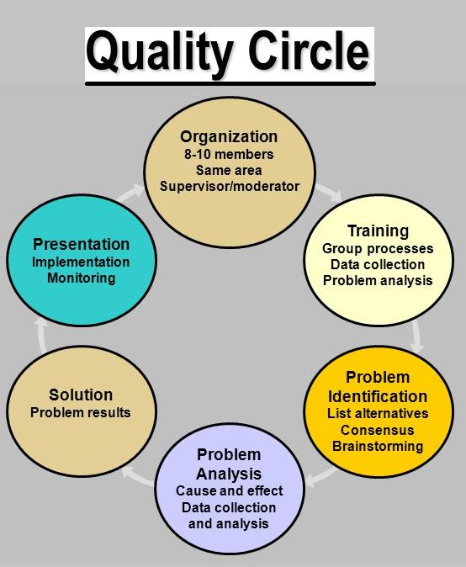
KCG
DEPARTMENT OF CSE
5

Slide 3
Quality Circles Structure Roles and Operating Rhythm
  Facilitator Coordinator supports multiple circles removes barriers
  Circle Leader runs meetings ensures follow-through
  Members provide ideas data testing implementation support
Rhythm
  weekly biweekly meetings 30–60 minutes focused agenda
Key inputs
  problem statements baseline data process knowledge customer feedback
Key outputs
  implemented improvements standardized work updates documented lessons learned
KCG
DEPARTMENT OF CSE
6

Slide 4
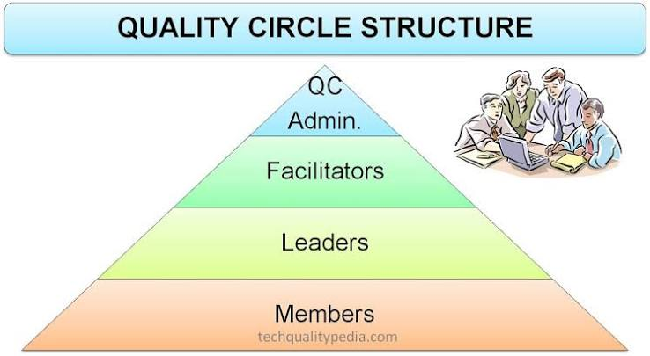
KCG
DEPARTMENT OF CSE
7

Slide 5
Quality Circles Problem-Solving Toolkit (Practical Set)
Quality Circles Problem-Solving Toolkit Practical SetCommon QC tools often 7 basic quality tools
  Check Sheet structured data capture
  Pareto Chart prioritize biggest contributors
  Cause-and-Effect Fishbone possible root causes
  Histogram distribution variation view
  Control Chart process stability over time
  Scatter Diagram relationship between variables
  Flowchart Process Map visual steps and handoffs
Typical method
  PDCA Plan Do Check Act for iterative improvement
KCG
DEPARTMENT OF CSE
8

Slide 6
Quality Function Deployment QFD What It Is
QFD A structured approach to translate Voice of the Customer VOC into technical requirements and then into process production requirements
Helps ensure the organization builds the right thing and aligns cross-functional teams early
Benefits fewer late changes improved customer satisfaction clearer priorities reduced rework
KCG
DEPARTMENT OF CSE
10

Slide 7
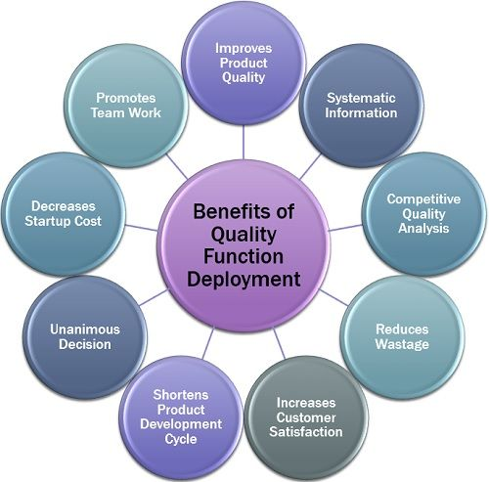
Benefits of QFD
KCG
DEPARTMENT OF CSE
7

Slide 8
QFD Core Steps From Customer Needs to Design Targets
Capture VOC interviews surveys complaints observation
Convert VOC into customer requirements clear measurable where possible
Identify engineering technical characteristics that affect each requirement
Analyze relationships strong medium weak between customer needs and technical characteristics
Benchmark competitors and set targets
Deploy into downstream matrices parts process planning control plans as needed
KCG
DEPARTMENT OF CSE
8

Slide 9
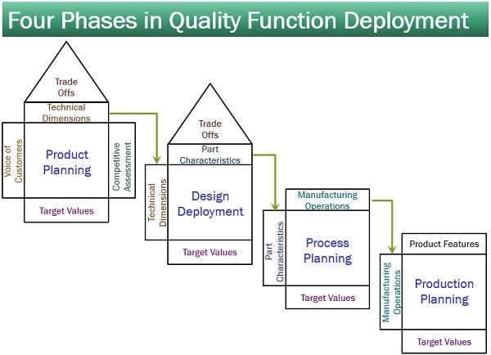
KCG
DEPARTMENT OF CSE
9

Slide 10
House of Quality HOQ How to Read the Matrix
Left side Whats prioritized customer needs with importance ratings
Top Hows technical characteristics measurable design process parameters
Middle relationship matrix how strongly each how impacts each what
Roof correlations among technical characteristics synergies tradeoffs
Bottom targets difficulty ratings and competitive assessment
Key takeaway HOQ converts customer language into actionable technical priorities
KCG
DEPARTMENT OF CSE
10

Slide 11
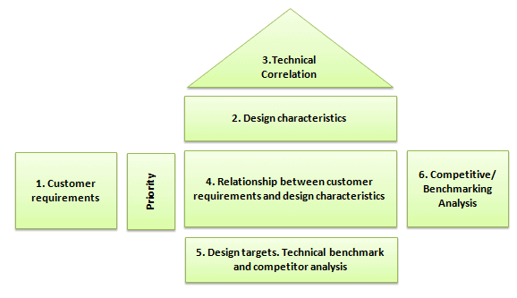
KCG
DEPARTMENT OF CSE
11

Slide 12
QFD Matrix
Relationship between
Customer Requirements and
Technical Descriptors
WHATs vs. HOWs
Technical Descriptors
Primary
Interrelationship between
Technical Descriptors
(correlation matrix)
HOWs vs. HOWs
Secondary
+9
Strong
Secondary
+3
Medium
Primary
+1
Weak
+9
Strong Positive
+3
Positive
-3
Negative
-9
Strong Negative
Prioritized Customer
Requirements
Customer Requirements
Technical
Competitive
Assessment
Our
A’s
B’s
Our
A’s
B’s
Customer Importance
Target Value
Scale-up Factor
Sales Point
Absolute Weight
Degree of Technical Difficulty
Target Value
Absolute Weight and Percent
Customer
Competitive
Assessment
Relative Weight and Percent
Prioritized Technical Descriptors

Slide 13
Technical Descriptors (How’s)
Secondary
Tertiary
Primary
Technical Descriptors
(HOWs)

Slide 14
Relationship Matrix
Technical Descriptors
Primary
Secondary
Secondary
Primary
Relationship between
Customer Requirements and
Technical Descriptors
WHATs vs. HOWs
Customer
Requirements
+9
Strong
+3
Medium
+1
Weak

Slide 15
Correlation Matrix
Interrelationship between Technical
Descriptors (correlation matrix)
HOWs vs. HOWs
Technical Descriptors
+9
Strong Positive
Primary
+3
Positive
-3
Negative
Secondary
-9
Strong Negative
Secondary
Primary
Relationship between
Customer Requirements and
Technical Descriptors
WHATs vs. HOWs
Customer Requirements
+9
Strong
+3
Medium
+1
Weak

Slide 16
Relationship between
Customer Requirements and
Technical Descriptors
WHATs vs. HOWs
Technical Descriptors
Primary
Interrelationship between
Technical Descriptors
(correlation matrix)
HOWs vs. HOWs
Secondary
+9
Strong
Secondary
+3
Medium
Primary
+1
Weak
+9
Strong Positive
+3
Positive
5
3
1
2
5
1
4
4
7
3
9
10
2
4
8
1
5
3
2
3
5
2
4
4
1.2
1.5
1
1
1.5
1
1.5
1
-3
Negative
-9
Strong Negative
Prioritized Customer
Requirements
Customer Requirements
1.5
1
15
3
Technical
Competitive
Assessment
Our
A’s
B’s
1 3 4 2
1 2 1 4
Our
A’s
B’s
Customer Importance
Target Value
Scale-up Factor
Sales Point
Absolute Weight
Degree of Technical Difficulty
1 8 4 2
9 8 2 5
Target Value
2 3 4 3
1 3 1 5
Absolute Weight and Percent
90
Customer
Competitive
Assessment
Relative Weight and Percent
133
Prioritized Technical Descriptors

Slide 17
Taguchi Quality Loss Function Concept
Traditional view within spec equals good out of spec equals bad
Taguchi view Any deviation from the target causes a loss to society customer e.g. dissatisfaction warranty inefficiency even if within specification
Loss increases as variation increases improving quality means reducing variation around the target not just meeting limits
KCG
DEPARTMENT OF IT
17

Slide 18
Taguchi Loss Function Practical Use in Decisions
Taguchi Loss Function Practical Use in DecisionsUsed to
  Compare design alternatives by expected loss not just pass fail
  Justify investments in process capability and robust design
  Prioritize improvement where small deviations create meaningful customer cost
Key idea
  Center the process on target and reduce variability via robust design and control of noise factors
KCG
DEPARTMENT OF IT
18

Slide 19
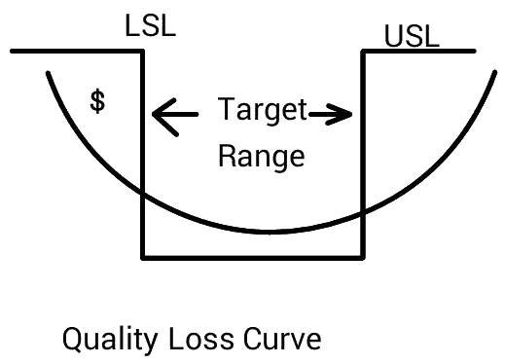
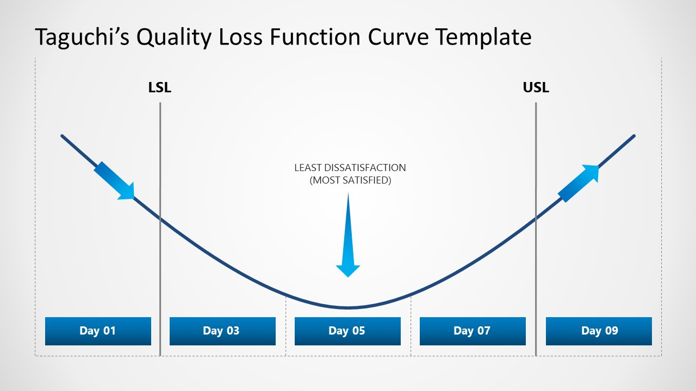
KCG
DEPARTMENT OF IT
19

Slide 20
Total Productive Maintenance TPM Overview
Total Productive Maintenance TPM Overview
TPM A system to maximize equipment effectiveness by involving everyone operators maintenance engineering in proactive maintenance and improvement
Goals
  Prevent breakdowns and defects from equipment issues
  Improve safety and reliability
  Reduce downtime speed losses and quality losses
TPM links directly to throughput quality stability and cost reduction
KCG
DEPARTMENT OF IT
20

Slide 21
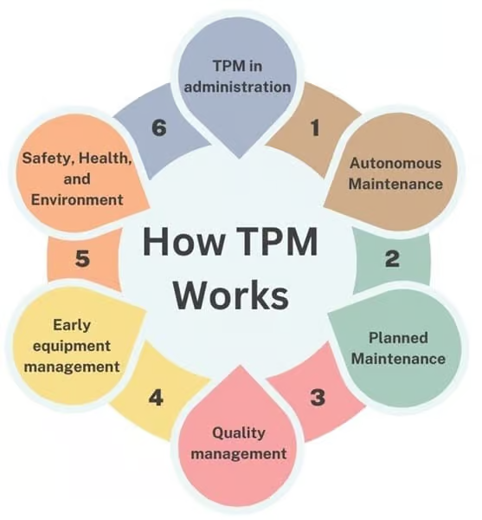
KCG
DEPARTMENT OF IT
21

Slide 22
TPM Pillars & Operator Involvement Core Practices
TPM Pillars Operator Involvement Core PracticesCommon TPM elements
  Autonomous Maintenance operators perform basic care cleaning lubrication inspection
  Planned Preventive Maintenance scheduled work to prevent failures
  Focused Improvement Kaizen small teams eliminate chronic losses
  Training Skills Development standard methods troubleshooting
  Early Equipment Management design for maintainability and reliability
Cultural shift
  I operate it I care for it shared ownership
KCG
DEPARTMENT OF IT
22

Slide 23
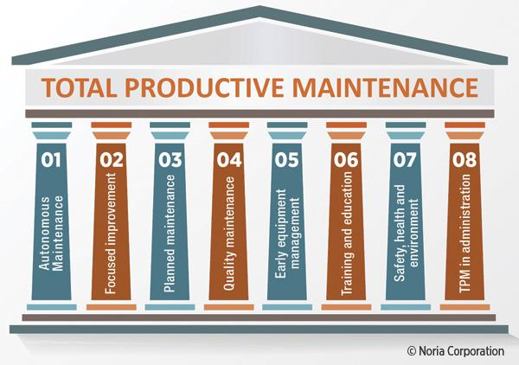
KCG
DEPARTMENT OF IT
23

Slide 24
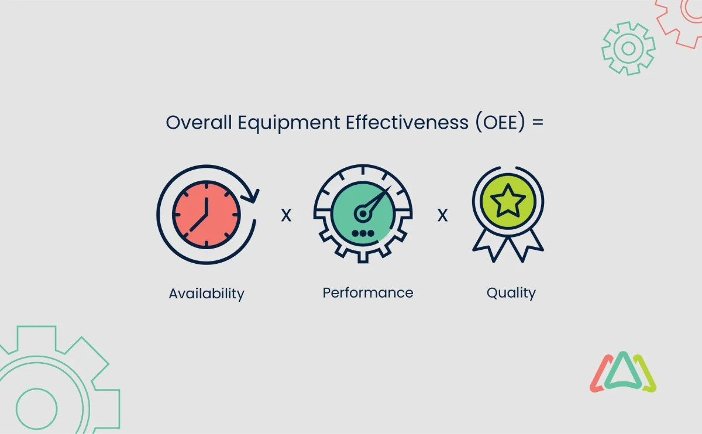
OEE Overall Equipment Effectiveness TPMs Key Performance Metric
OEE Overall Equipment Effectiveness TPMs Key Performance Metric
OEE measures how effectively equipment is used versus its full potential
Components
  Availability percent of scheduled time equipment runs losses breakdowns changeovers
  Performance speed efficiency losses small stops reduced speed
  Quality good output rate losses defects rework
Used to pinpoint downtime speed or defects as main constraint
KCG
DEPARTMENT OF IT
24

Slide 25
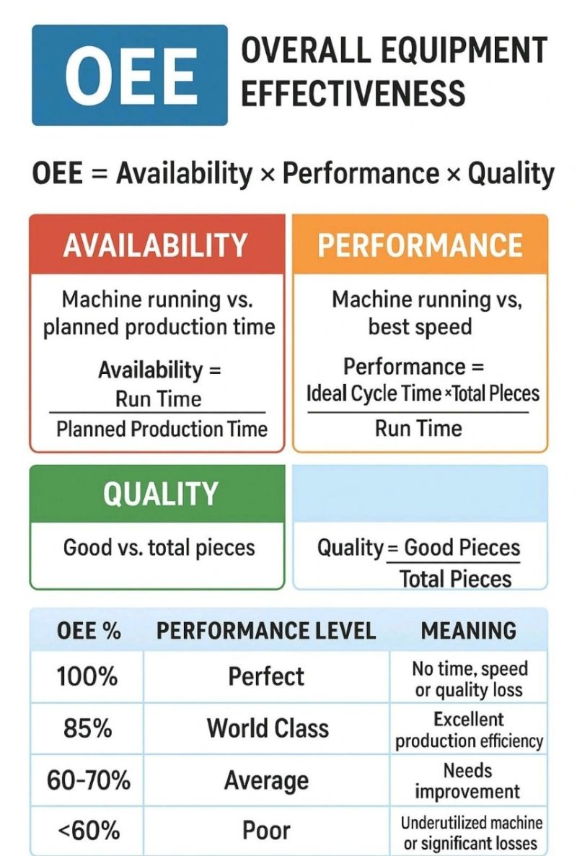
KCG
DEPARTMENT OF IT
25

Slide 26
Improvement Needs How to Identify What to Fix First
Improvement Needs How to Identify What to Fix FirstStart with Where is the biggest pain? using
  Customer complaints returns service failures
  Process data scrap rework cycle time delays
  Safety incidents near misses
  Cost hot spots expedites overtime warranty
Apply prioritization tools
  Pareto analysis risk scoring impact effort matrix
Write a strong problem statement
  what where when how big and business customer impact
KCG
DEPARTMENT OF IT
26

Slide 27
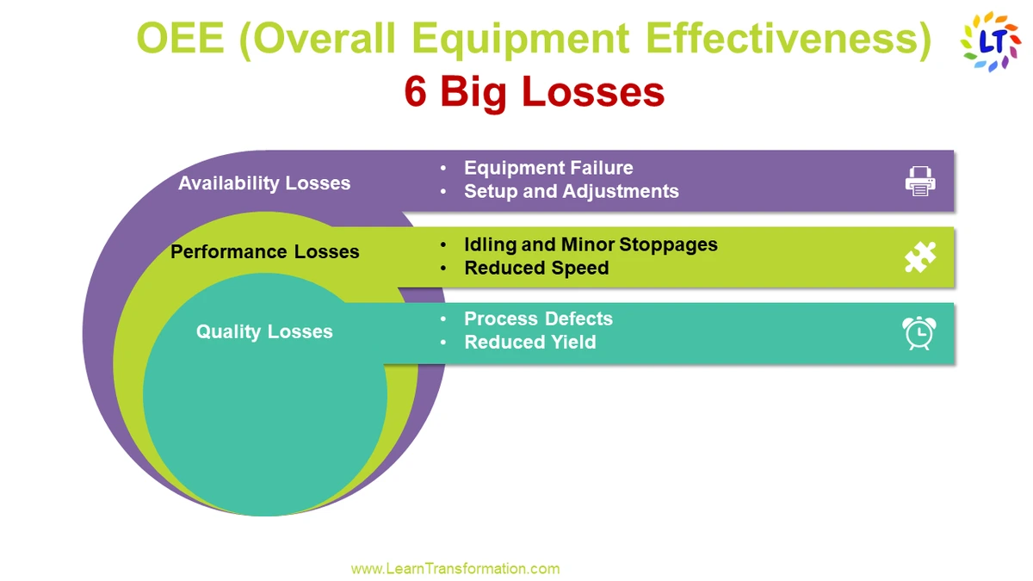
KCG
DEPARTMENT OF IT
27

Slide 28
Leading vs Lagging Indicators for performance measure .Why You Need Both
Lagging indicators results after the fact e.g. warranty claims monthly defect rate
Leading indicators predictors of future performance e.g. process audit scores preventive maintenance compliance training completion control plan adherence
Use leading indicators to manage daily work use lagging indicators to validate overall outcomes
KCG
DEPARTMENT OF IT
28

Slide 29
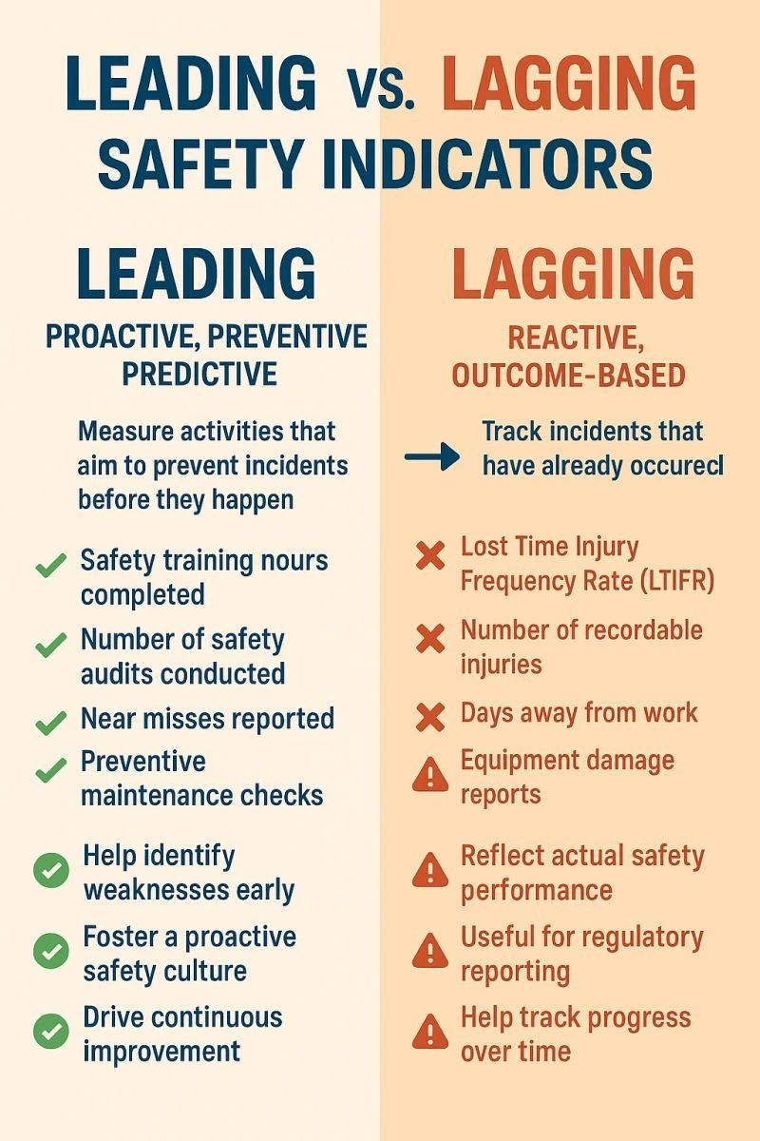
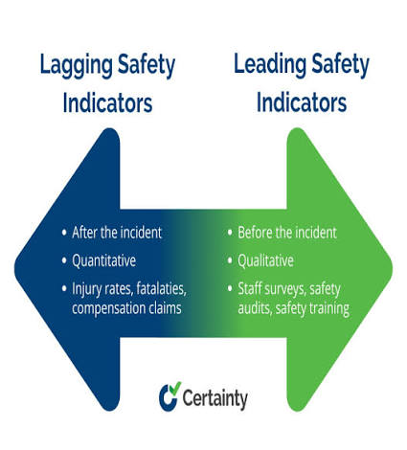
KCG
DEPARTMENT OF IT
29

Slide 30
Cost of Quality COQ The Four Categories
Prevention Costs training process design supplier qualification mistake-proofing
Appraisal Costs inspection testing audits measurement systems
Internal Failure Costs scrap rework retest downtime due to defects
External Failure Costs returns warranty complaints recalls lost customers
Core message shift investment upstream prevention to reduce expensive failures
KCG
DEPARTMENT OF IT
30

Slide 31
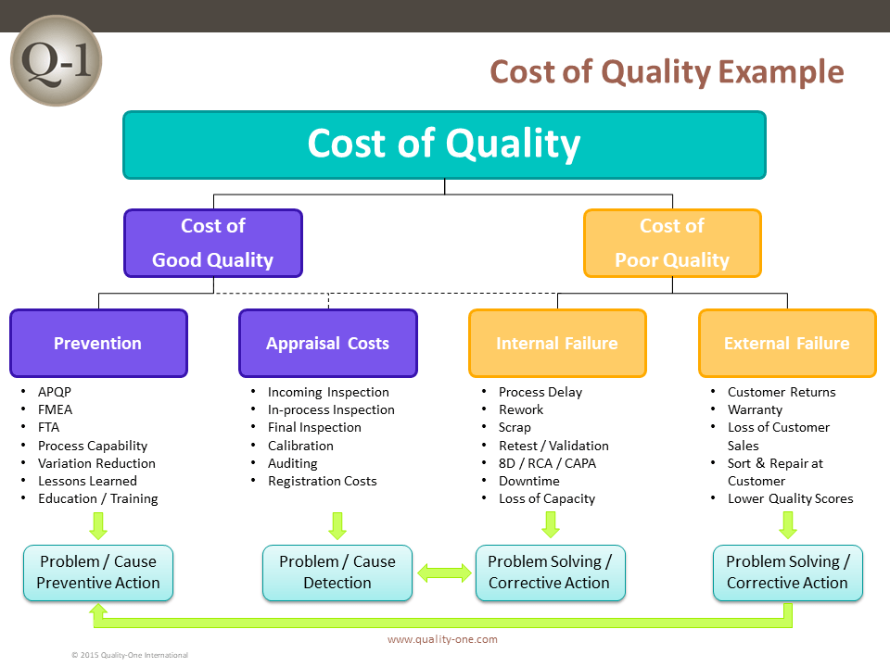
KCG
DEPARTMENT OF IT
31

Slide 32
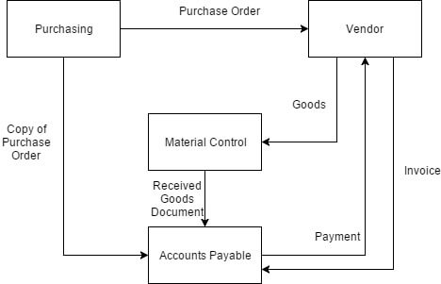
Business Process Reengineering BPR What It Is and When to Use It
BPR fundamental rethinking radical redesign of processes to achieve dramatic improvements in cost quality service and speed
When BPR fits
  Process is fundamentally broken or outdated
  Incremental improvement Kaizen is too slow for the gap
  Technology or operating model must change significantly
Difference from continuous improvement
  BPR is transformational Kaizen is incremental
KCG
DEPARTMENT OF IT
32

Slide 33
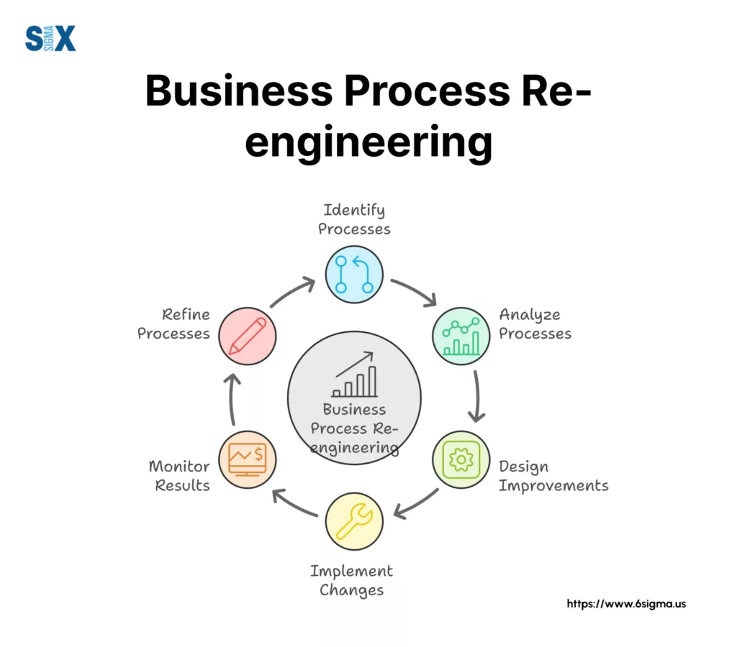
KCG
DEPARTMENT OF IT
33

Slide 34
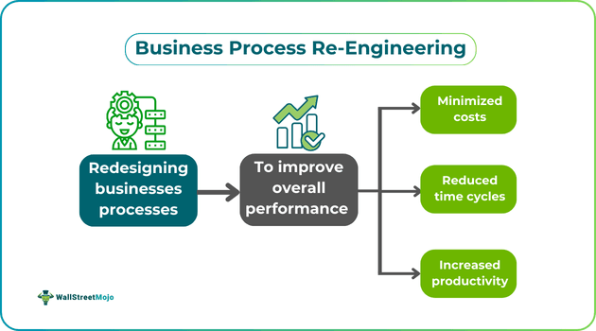
KCG
DEPARTMENT OF IT
34

